Slide 1
Software Engineering
Module 5
Software Requirements – Concepts & Principles
Dr. Shai Koenig
Open University
Department of Computer Science

Slide 2
Framework for software development activities
Inputs
Basic concepts
Principles
Process
Techniques
Tools
Problems
Software
Development
Activity
Outputs
Verification

Slide 3
Documenting the software development process
- The Software Engineering Process Matrix
 | WORK-PRODUCTS · specifications · descriptions · drawings · source code - … | WORK-PRODUCT DEVELOPMENT PRATICES · procedures · standards · techniques · tools | SW QUALITY ASSURANCE PRACTICES · wp evaluations · process assessments · internal auditing - corrective action | WORK-PRODUCT CONTROL PRACTICES · document control · source control · version control · change control
Software Requirements | X | X
Architectural Design
Software Construction
Integration
Validation testing
Release & Deployment
Maintenance & Support

Slide 4

Software Requirements
Basic Concepts
  Introduction to Requirements Engineering
  Software Requirements Taxonomy
Product
Process
Practices
  Requirements Specification Techniques
  Requirements Management Practices
Problems

Slide 5
Introduction to Requirements Engineering Changing attitudes
Old attitudes
Well, we just do not have the time ...
We know what has to be done, so let’s get on with it!!!
We’ve got to begin coding, otherwise we’ll never finish...
Let’s hurry through the requirements and design so that we can finish the coding as soon as possible because we’ll need a lot of time for debugging !!!
New attitudes
The hardest part of building a software system is deciding precisely what to build.
No other part of the conceptual work is as difficult as establishing the detailed requirements, including all the interfaces to people, to machines, and to other software systems.
No part of the work so cripples the resulting system if done wrong.
F. Brooks
“No Silver Bullet: Essence and Accidents of Softwrae Engineering”
Computer, April, 1987.

Slide 6
Software Requirements – Concepts & Principles
Basic Concepts
  Introduction to Requirements Engineering
  Software Requirements Taxonomy
Product
Process
Practices
  Requirements Specification Techniques
  Requirements Management Practices
Problems

Slide 7
Software Requirements Taxonomy
Level
Type
Area
Mode/Style

Slide 8
Levels of Requirements
Marketing
* Requirements
Marketing-level
System
* Requirements
Design
System-level
Software
* Requirements
Design
Hardware
* Requirements
Design
Software-level
SW Component
* Requirements
Design
SW Subsystem
* Requirements
Design
SW Component-level

Slide 9
Software Requirements Type
Functional Requirements
Non-functional Requirements
  product
  process
Interface Requirements
  user interface
  hardware-software
  software-software
  communications - software
Inverse Requirements [Thou shalt not ...]
Data Requirements

Slide 10
Functional Requirements
functional requirements specify
  external behavior of the system
  the services that the system should provide
functional requirements usually involve some combination of
  Inputs, stimuli
  Pre-conditions
  Processing [as little as possible]
  Post-conditions
  Outputs, results, responses
  Exception handling
functional requirements should NOT be defined using a computational model – this leads to design

Slide 11
Non-functional requirements
Define system properties and constraints e.g.
  reliability
  response time
  storage requirements
  I/O device capability
  portability
Non-functional requirements may
  be attached to specific functional requirements or
  may be global - i.e., place constraints on the system as a whole rather than on specific system functions
Nonfunctional requirements include process requirements such as mandating a particular development technology [e.g., object-oriented development], programming language or development method
Non-functional requirements may be more critical than functional requirements. If these are not met, the system is useless.

Slide 12
Non-functional Requirements Sources
Product requirements
  Requirements which specify that the delivered product must behave in a particular way e.g. execution speed, reliability, etc.
Organisational requirements
  Requirements which are a consequence of organizational policies and procedures e.g. process standards used, implementation requirements, etc.
External requirements
  Requirements which arise from factors which are external to the system and its development process e.g. interoperability requirements, legislative requirements, etc.

Slide 13
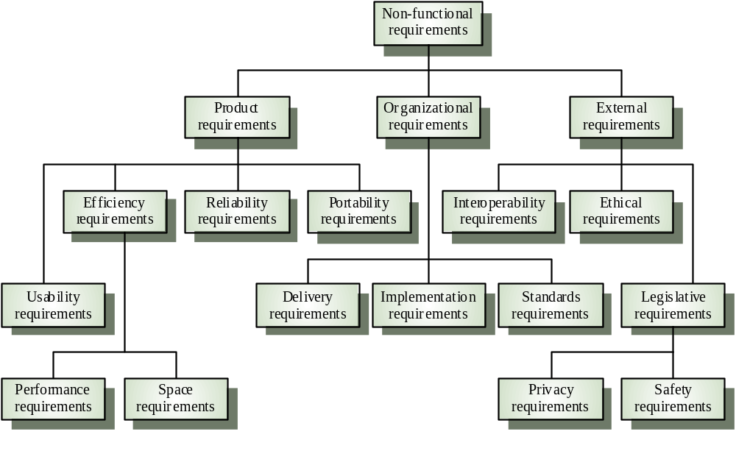
Non-functional requirement types

Slide 14
Interface specification
Almost all software systems operate in an environment where there are other system components or other systems.
This requires the precise specification of interfaces.
Three types of interfaces may have to be defined in a requirements specification
  Procedural interfaces, e.g. interfacing systems may offer a range of services
  Data interfaces - Data structures are exchanged.
  Representation interfaces - Specific data representation patterns may have to be used.

Slide 15
Procedural interface example
package Print_server is
procedure Initialise (P: PRINTER) ;
procedure Print (P: PRINTER ; F: PRINT_FILE ) ;
procedure Display_print_queue (P: PRINTER ) ;
procedure Cancel_print_job (P: PRINTER; N: PRINT_ID) ;
procedure Switch_printer (P1, P2: PRINTER; N: PRINT_ID) ;
end Print_server ;

Slide 16
Data interface example
type MESSAGE is record
Sender : SYSTEM_ID;
Receiver : SYSTEM_ID;
Dispatch_time : DATE;
Length: MESSAGE_LENGTH ;
Terminator: CHARACTER ;
Message : TEXT;
end record;
type SYSTEM_ID is range 20_000..30_000 ;
type YEAR_TYPE is range 1980..2080 ;
type DATE is record
Seconds: NATURAL ;
Year: YEAR_TYPE ;
end record ;
type MESSAGE_LENGTH is range 0..10_000 ;
type TEXT is array (MESSAGE_LENGTH) of CHARACTER ;

Slide 17
Size representation
for SYSTEM_ID’SIZE use 2*BYTE ;
for YEAR_TYPE’SIZE use 2*BYTE ;
for MESSAGE_LENGTH’SIZE use 2*BYTE ;

Slide 18
Representation interface example
type STATE is (Halted, Waiting, Ready, Running);
for STATE use (Halted => 1, Waiting => 4, Ready => 16,
Running => 256);

Slide 19
Software Requirements Areas
In specific domains, it is possible to classify requirements by pre-defined areas
For example in telecommunications software -
  Configuration
  Monitoring [alarms]
  Provisioning
  Billing
  Security
  …

Slide 20
Software Requirements – Concepts & Principles
Basic Concepts
  Introduction to Requirements Engineering
  Software Requirements Taxonomy
Product
Process
Practices
  Requirements Specification Techniques
  Requirements Management Practices
Problems

Slide 21

The Software Requirements Specification
Marketing
Requirements
Software
Requirements
Analysis &
Specification
Enhancement
Requests
SRS
System Requirements
and Design
Existing
Systems
...

Slide 22
The Software Requirements Specification
The SRS is the official statement of what is required of the software under development
Note that if the software is only a part of a larger system, then System Requirements and Design Specifications must precede the Software Requirements Specification.
The SRS is NOT a design document. As far as possible, it should specify WHAT the software should do rather than HOW it should do it

Slide 23




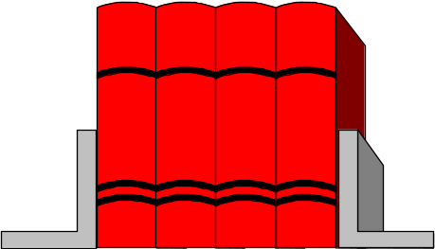


SRS Users and Uses
Basis for project
planning and tracking
Basis for “customer”
agreement
Basis for design,
implementation
and evolution
Software
Requirements
Specification
Basis for system/product
testing and validation

Slide 24
Goals of a SRS
basis for agreement between “customer” and “developer”
basis for estimating costs and schedules
basis for development
basis for design verification
basis for software validation
basis for evolution

Slide 25
Contents of a SRS
Fundamental Questions
Who does the software serve?
With whom or with what does the software interact?
How does the SW interact?
What does the SW do?
How well does it do it?
What additional requirements must the SW satisfy?

Slide 26
Contents of a SRS
Fundamental Questions
Who does the software serve?
With whom or with what does the software interact?
How does the SW interact?
What does the SW do?
How well does it do it?
What additional requirements must the SW satisfy?
software
context

Slide 27
Contents of a SRS
Fundamental Questions
Who does the software serve?
With whom or with what does the software interact?
How does the SW interact?
What does the SW do?
How well does it do it?
What additional requirements must the SW satisfy?
software
context
interfaces

Slide 28
Contents of a SRS
Fundamental Questions
Who does the software serve?
With whom or with what does the software interact?
How does the SW interact?
What does the SW do?
How well does it do it?
What additional requirements must the SW satisfy?
software
context
interfaces
functional
requirements

Slide 29
Contents of a SRS
Fundamental Questions
Who does the software serve?
With whom or with what does the software interact?
How does the SW interact?
What does the SW do?
How well does it do it?
What additional requirements must the SW satisfy?
software
context
interfaces
functional
requirements
non-functional
requirements

Slide 30
Attributes of a SRS
Correct
Unambiguous
Complete
Consistent
Ranked for importance and/or stability
Verifiable
Modifiable
Traceable
Feasible
from IEEE Std. 830-1993 [IEEE Recommended Practice for Software Requirements Specification]

Slide 31
IEEE SRS Organization and Structure
1. Introduction
  1.1 Purpose
  1.2 Scope
  1.3 Glossary
  1.4 References
  1.5 Document Overview
2. Overall Description
  2.1 Product Perspective
  2.2 Product Functions
  2.3 User Characteristics
  2.4 Constraints
  2.5 Assumptions and Dependencies
3. Specific Requirements
[see 5.3.1-5.3.8 and Annex A of IEEE Std 830 -1993 for details regarding the contents and organization of this part of the SRS]
from IEEE Std. 830-1993 [IEEE Recommended Practice for Software Requirements Specification]

Slide 32
Software Requirements – Concepts & Principles
Basic Concepts
  Introduction to Requirements Engineering
  Software Requirements Taxonomy
Product
Process
Practices
  Requirements Specification Techniques
  Requirements Management Practices
Problems

Slide 33
SW Requirements Activities
bound requirements
partition requirements
identify requirements
represent requirements
analyze requirements
verify requirements
validate requirements
control requirements

Slide 34
Bound requirements
Question: How many sides does a system have ?
Answer: Two - An inside and an outside
Determine the software context
  external entities [actors]
    principal
    secondary
  external interfaces
external
entities
external
interfaces
entity under
specification
Context Diagram

Slide 35
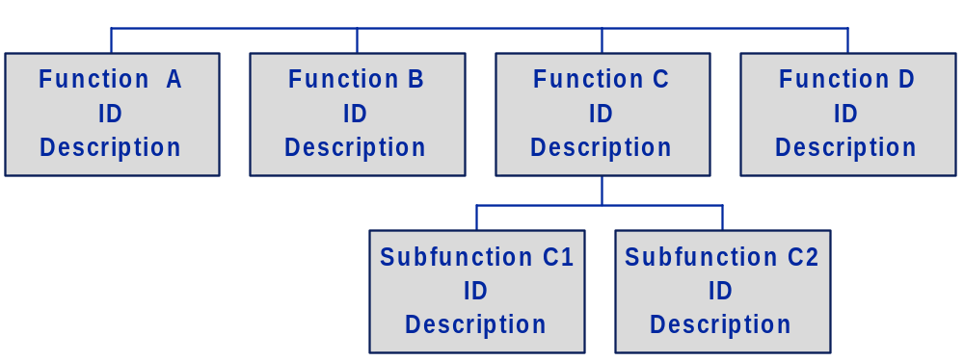
Partition requirements
Purpose
  organize the process
  organize the work-product
Approaches
  system design
  viewpoints
  functional decomposition
  object-oriented
  hybrid approach

Slide 36
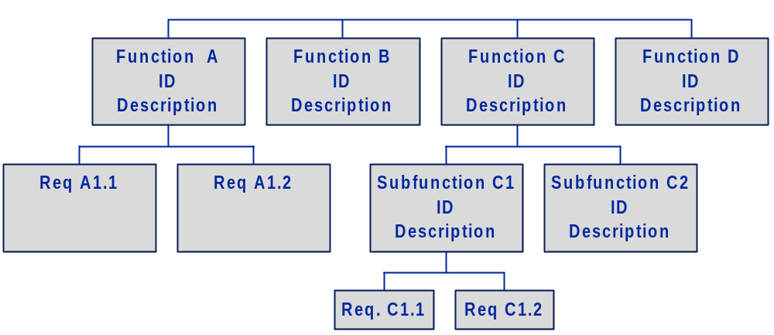
Identify requirements
Elicitation from people
  customers
  end-users
  domain experts
  marketing
  implementers
From systems engineering
  system reqs spec
  system design spec
From existing systems
  older systems
  competing systems
  related systems

Slide 37
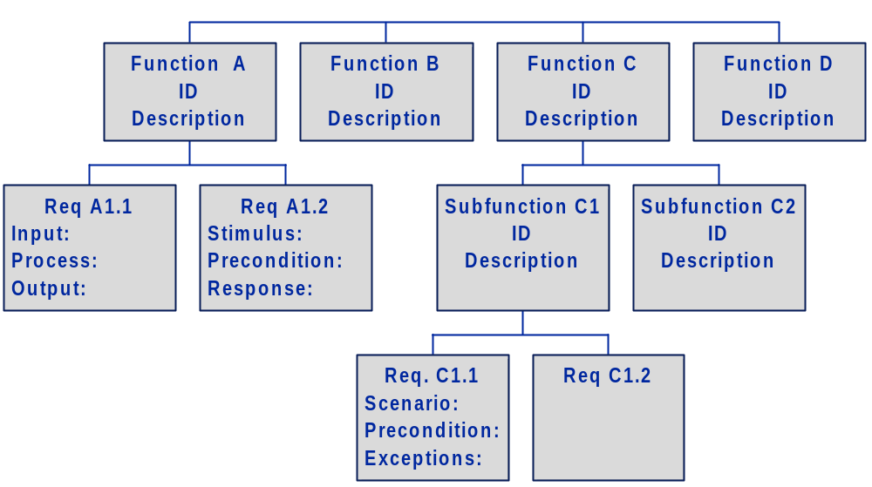
Represent requirements
Interaction Requirements
  use cases
  scenarios
Transformations
  structured analysis [dfd’s]
  flowcharts
Control
  finite state machines
  statecharts
  SA/RT
Data
  Entity-relationship modeling
  relational model
Domain Requirements
  Class diagrams
User interface
  prototypes

Slide 38
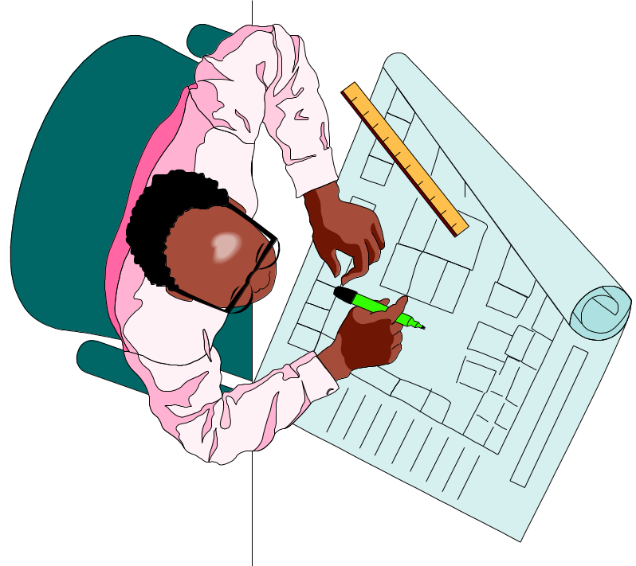
Analyze requirements
identify problems and resolve
  ambiguity, incompleteness, inconsistency
classification of requirements
  necessity: mandatory, recommended, suggested
  stability: stable, volatile
  effort:
evaluation of feasibility
  technical
  operational
  economic
analysis techniques
  prototyping
  simulation
  traceability
  test planning
  static analysis tools

Slide 39

Verify requirements
What
  work-product
How
  Critical reading
  Prototyping
  Checklists
  Reviews
  Test Plans
  “Execution”
Who
  Customers
  System engineers
  Sw requirements engineers
  Designers
  Testers
  Quality assurance staff

Slide 40
Requirements Verification Checklist
1.
CONTENT
1.1.
Is the context of the software under requirements specification (SUS) explicitly and clearly defined including the external entities with which the software interacts and the mechanisms through which they interact?
1.2.
Are all the interface mechanisms explicitly and clearly defined, including handshaking, error-checking, protocols, time-outs ?
1.3.
Are all the inputs to the software explicitly and clearly defined, including their source, possible values, format, frequency ?
1.4.
Are all the outputs of the software explicitly and clearly defined, including their destination, possible values, format, frequency ?
1.5.
Are the software’s operation modes (such as initialization, backup, stand-by, recovery, shut-down, and degraded operation modes) described?
1.6.
Are all the functions to be performed by the software explicitly and clearly defined?
1.7.
Are all performance requirements explicitly and clearly defined ?
1.8.
Are all reliability requirements explicitly and clearly defined ?
1.9.
Are recovery requirements explicitly and clearly defined ?
1.10.
Are all the system constraints (e.g., cpu speed, memory, secondary storage) clearly defined ?

Slide 41
Requirements Verification Checklist (con’t)
2.
UNDERSTANDABILITY CHARACTERISTICS
2.1.
Are the requirements formulated and expressed in a coherent and presentable manner (e.g., a single Requiremments Spec document, a number of such documents, prototypes) ?
2.2.
Is the Requirements Specification understandable to its users?
2.3.
Is the Requirements Specification clear enough to be turned over to an independent group for design and implementation ?
2.4.
Is each requirement uniquely identifiable ?
3.
COMPLETENESS CHARACTERISTICS
3.1.
Are the requirements complete in the sense that if the software satisfies every requirement it will be be acceptable ?
3.2.
Where incompletenesses do exist, are they explicitly noted ?
3.3.
Are the requirements specified at a fairly consistent level of detail ? Do some requirements require more detail ? Do some require less detail ?
3.4.
Do the requirements avoid specifying design decisions ?

Slide 42
Requirements Verification Checklist (con’t)
4.
CONSISTENCY CHARACTERISTICS
4.1.
Is the Requirements Specification internally consistent ?
4.2.
Is the Requirements Specification consistent with other project information ?
5.
FEASIBILITY CHARACTERISTICS
5.1.
Is each requirement technically feasible - i.e., can be implemented using available technologies ?
5.2.
Is each requirement operationally feasible - i.e., fits the operational environment of the software ?
5.3.
Is each requirement economically feasible - i.e., can be implemented in a cost-effective manner?
6.
TESTABILITY CHARACTERISTICS
6.1.
Will each requirement be testable in the final system ?
6.2.
Will it be possible for independent testing to determine whether each requirement has been satisfied ?

Slide 43
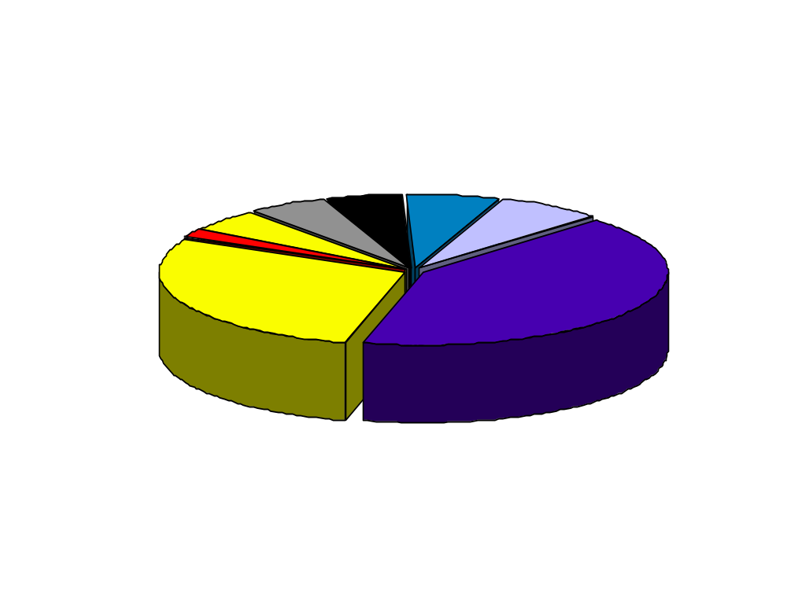
Is the requirements activity worth the effort ?
What happens if we don’t do it right ?
What is the percentage of errors attributable to problems in the requirements activity ?
Environment
Data
Interface
Other
Human
Documentation
Requirements
Errors
Logic Design
Percentage of errors classified by problem type on a US Air Force project.
“Requirements errors are the most frequent class of error.”
Sheldon, et al
IEEE Software, July 1992
Notes:
07/20/98
18

Slide 44
Is the requirements activity worth the effort ?
What is the cost of requirements errors ?
Stage
“All together, the results show as much as a 200:1 cost ratio between finding errors in the requirements and maintenance stages of the software lifecycle.”
.1-.2
Requirements Time
0.5
Design
1
Coding
2
Unit Test
5
Acceptance Test
20
Maintenance
Relative Cost to Repair
Boehm ‘76, 88
Notes:
07/20/98
16

Slide 45

Validate requirements
establish agreement on acceptance criteria
requirements validation test planning
requirements validation test execution

Slide 46
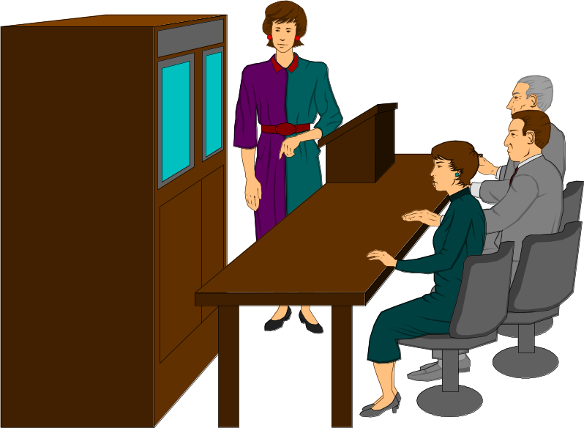
Control requirements
establish a process to control requirements changes during development
change process
  request
  analyze, decide and plan
  update related work-products
  verify
  validate
CCB - configuration control board

Slide 47
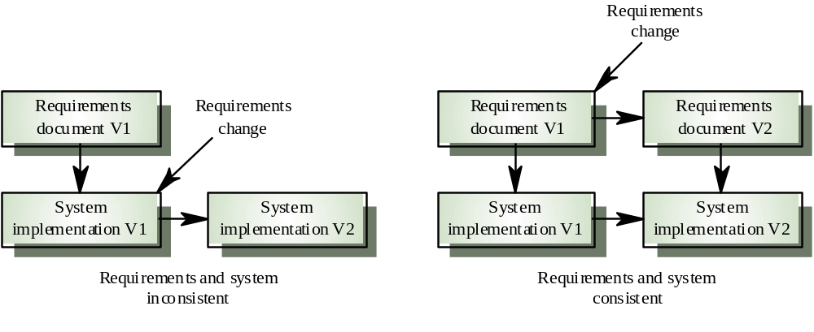
Control Requirements Evolution

Slide 48
Control Requirements Evolution
Alternatives
Update original spec
Write “delta” specs

Slide 49
Software Requirements – Concepts & Principles
Basic Concepts
  Introduction to Requirements Engineering
  Software Requirements Taxonomy
Product
Process
Practices
  Requirements Specification Practices
  Requirements Management Practices
Problems

Slide 50
Requirements Practices
correctness
“un-ambiguous”
completeness
consistency
understandability
testability
Requirements Specification
Current State of Practice
natural language, textual, informal prose
  The product will ...
  The system shall ...
  The software should ...
organized into documents, chapters, sections, paragraphs, ... using functional decomposition
Documents serve both as the means to record requirements and as the end-product of the requirements specification process
The main tools are templates and word processing systems
The quality of the requirements specification is wanting
Potential for requirements management is very limited
Requirements
Management
associativity
traceability
attribution
accessibility
change mgmt
version mgmt

Slide 51
Software Requirements – Concepts & Principles
Basic Concepts
  Introduction to Requirements Engineering
  Software Requirements Taxonomy
Product
Process
Practices
  Requirements Specification Practices
  Requirements Management Practices
Problems

Slide 52
Requirements Specification Practices -
General Guidelines
Strive for brevity and clarity
Define your terms carefully and use them consistently
  One term, one concept
Avoid duplication
Use formats and notations that are relevant to the problem
Information should be uniquely identified
Functional requirements should be atomic
Related requirements should be grouped together
Functional and non-functional requirements should be distinguished
Layer the information
Structure for change
...

Slide 53
Requirements Specification Practices - Requirements Rationale
It is important to provide rationale with requirements
This helps the developer understand the application domain and why the requirement is stated in its current form
Particularly important when requirements have to be changed. The availability of rationale reduces the chances that change will have unexpected effects

Slide 54
Requirements Specification Practices -Requirements Traceability
Requirements traceability means that related requirements are linked in some way and that requirements are (perhaps) linked to their source
Traceability is a property of a requirements specification which facilitates finding related requirements
Very useful in impact analysis
Some CASE tools provide traceability support facilities. For example, they may be able to find all requirements which use the same terms

Slide 55
Requirements Specification Practices -
Traceability techniques
Assign a unique identifier to each requirement
Cross-reference related requirements using this unique identifier
Produce a cross-reference matrix for each requirements document showing related requirements. Several matrices may be necessary for different types of relationships
  within a single deliverable
  between distinct deliverables
    traceability to system requirements
    traceability to test specifications
    traceability to design
Traceability is difficult to support without automated support [e.g., databases]

Slide 56
Requirements Specification Techniques
Functional Decomposition
Natural language
Structured natural language
Prototyping
Entity Relationship Modeling
Use Cases and Scenarios
Control Modeling [state-based approaches, e.g., Statecharts, SDL]
Structured Analysis [SA, SADT]
Structured Analysis/RT
Requirements specification languages [e.g., PSL/PSA, RSL]
Formal Specification Languages [e.g., Z, VDM, Algebraic specification]
...
Note these are not mutually exclusive

Slide 57
Requirements Specification Techniques Hierarchical Functional Decomposition

Slide 58
Requirements Specification Techniques
Natural Language Specification
Natural language, supplemented by diagrams and tables is the norm today for writing requirements specifications
This is universally understandable but a number of problems often arise
  Lack of clarity. Natural language relies on the specification readers and writers using the same words for the same concept. Precision is difficult without making the document difficult to read
  A natural language specification is over-flexible and subject to different interpretations
  Lack of consistency.
  Requirements confusion. Functional and non-functional requirements tend to be mixed-up
  Requirements amalgamation. Requirements are not partitioned by language structure. Several different requirements may be expressed together

Slide 59
Requirements Specification Techniques
Structured natural language specification
A limited form of natural language may be used to express requirements
This removes some of the problems resulting from ambiguity and flexibility and imposes a degree of uniformity on a specification
Often supported using a forms-based or template approach

Slide 60
Requirements Specification Techniques
Form-based specifications
Definition of the function or entity
Description of inputs and where they come from
Description of outputs and where they go to
Indication of other entities required
Pre and post conditions (if appropriate)
The side effects (if any)

Slide 61
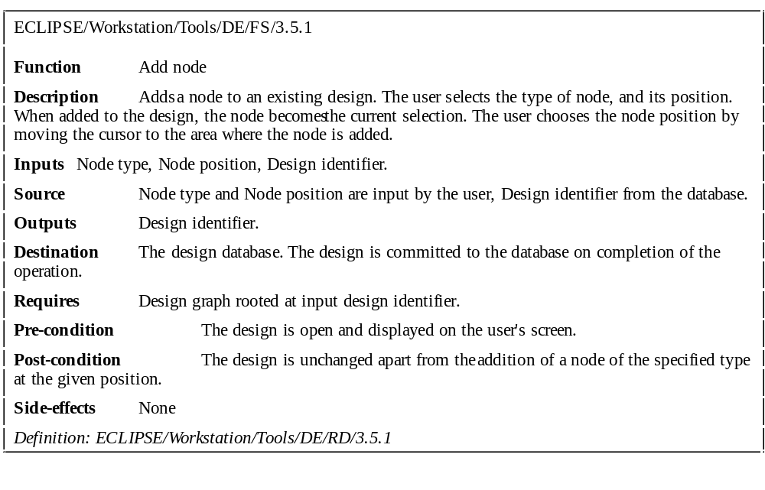
Requirements Specification Techniques
Form-based specification

Slide 62
Requirements Specification Techniques Prototyping
The objective of requirements prototyping is to derive or validate the system/software requirements.
  The prototyping process starts with those requirements which are poorly understood
  The principal use is to help customers and developers understand the requirements for the system/software.
  The prototype may be used for user training before a final system is delivered
The objective of evolutionary prototyping is to deliver a working system to end-users. The development starts with those requirements which are best understood.

Slide 63
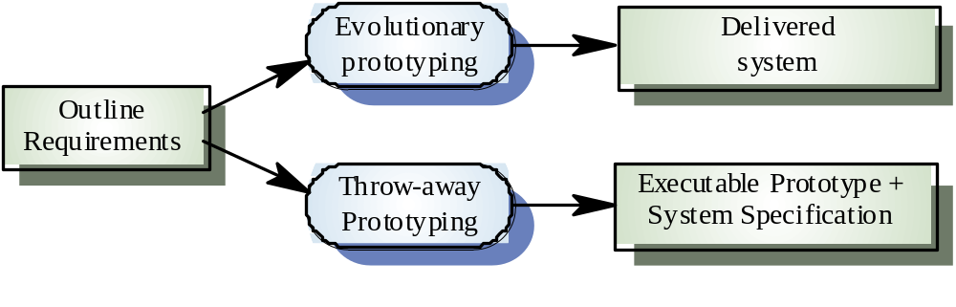
Requirements Specification Techniques Approaches to prototyping

Slide 64
Requirements Specification Techniques Requirements Prototyping Benefits
Misunderstandings between software users and developers are exposed
Missing services may be detected
Confusing services may be identified
A working system [or part thereof] is available early in the process
The prototype may serve as a basis for deriving a system specification
Reduces requirements risk

Slide 65
Requirements Specification Techniques Requirements Prototyping Pitfalls
Some parts of the requirements (e.g. safety-critical functions) may be impossible to prototype and so don’t appear in the specification
Non-functional requirements cannot, in general, be adequately tested in a prototype
The requirements prototype should NOT be considered as a final system
  Some system characteristics may have been left out
  There is no specification for long-term maintenance
  The system will be poorly structured and difficult to maintain

Slide 66
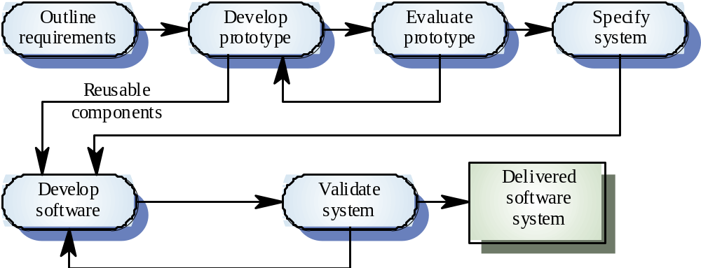
Requirements Specification Techniques Requirements prototyping

Slide 67
Requirements Specification Techniques
User interface prototyping
UI development consumes an increasing part of overall system development costs
It is impossible to pre-specify the look and feel of a user interface in an effective way. Prototyping is essential
Prototyping may use very high level languages such as Smalltalk or Lisp
User interface generators may be used to ‘draw’ the interface and simulate its functionality

Slide 68
Requirements Specification Techniques Prototyping techniques
Very high-level languages
Application generators and 4GLs
Composition of reusable components

Slide 69
Software Requirements – Concepts & Principles
Basic Concepts
  Introduction to Requirements Engineering
  Software Requirements Taxonomy
Product
Process
Practices
  Requirements Specification Practices
  Requirements Management Practices
Problems

Slide 70
Requirements Management Practices
Marketing
Requirements
Spec
Acceptance
Test
Spec
System
Requirements
Spec
System
Test
Spec
System
Design
Spec
System
Integration
Spec
Current requirement management practices
are based on document driven approaches !
Software
Requirements
Spec
Software
Test
Spec
Design and
Construction
Artifacts

Slide 71
Requirements Management Practices
Marketing
Reqs
Spec
Acceptance
Test
Spec
System
Reqs
Spec
System
Test
Spec
Software
Requirements
Spec
Software
Test
Spec
Software
Reqs
Spec
Software
Test
Spec
Document-driven approaches do not provide an adequate basis for
Coordinating engineering information
  Eliminating duplication
  Maintaining consistency
Coordinating the development work
  Team/concurrent development
Inter-relating different types of engineering information
  E.g. feature requests, marketing requirements, technical requirements, test cases, releases, defects, action items
Assigning and maintaining management attributes
  Author, status, priority, required effort, difficulty, stability, ...
Accessing engineering information
  Physical access, viewpoints, search capabilities
Controlling the evolution of engineering information
  Who can change what and when and with what impact
Standardizing work methods
Design and
Construction
Artifacts

Slide 72
Requirements Management Practices
Is there another approach ?
Requirements management
is a form of
information management
so why not apply
information management approaches ?
For example
Database technology
Client server architecture
Query capabilities
Graphical User Interfaces

Slide 73
Requirements Management Practices
An information systems approach to Requirements Management based on Database Technology !
queries
reports
documents
audit trails
Requirements
Repository
organize
enter
relate
change
analyze
Database Schema
Requirements
Data Base

Slide 74
An information systems approach to
Requirements Management provides multi-user support !
Project Management
Requirements
Repository
Marketing Group,
Product Management
Database Schema
Development Groups
[System, HW, SW]
Requirements
Data Base
Validation Group

Slide 75
What about the documents that we are used to ?
Requirements Management Practices
Notes:
07/20/98
33

Slide 76
Requirements Management Practices
An information systems approach to
Requirements Management provides significant benefits!
requirements information is multi-dimensional
relationships between requirements are easily established
requirements information is not duplicated
requirements consistency is easier to attain
easier to maintain up-to-date-ness
information evolves naturally
changes are more easily controlled
easier to find information
easier to coordinate development - multi-user support

Slide 77
Requirements Management Tools
DOORS
Rational Requisite Pro
RTM
Calibur
Core
Slate
“In-house”
...

Slide 78
Software Requirements – Concepts & Principles
Basic Concepts
  Introduction to Requirements Engineering
  Software Requirements Taxonomy
Product
Process
Practices
  Requirements Specification Techniques
  Requirements Management Practices
Problems

Slide 79
Common problems and risks
Large software systems address wicked problems - problems which are so complex that they can never be quite fully understood and where understanding develops during the system development. Therefore, requirements are normally both incomplete and inconsistent
Not all the stakeholders are identified
The “customer” has only a vague idea of what is required
The developer is willing to proceed with the “vague idea” on the assumption that “we’ll fill in the details as we go”
The customer keeps changing requirements
Customers/users and developers have different specification needs
It is sometimes difficult to decide if a requirement is functional or a non-functional [For example, requirements for safety are concerned with non-functional properties but may require functions to be added to the system]

